Slide 1

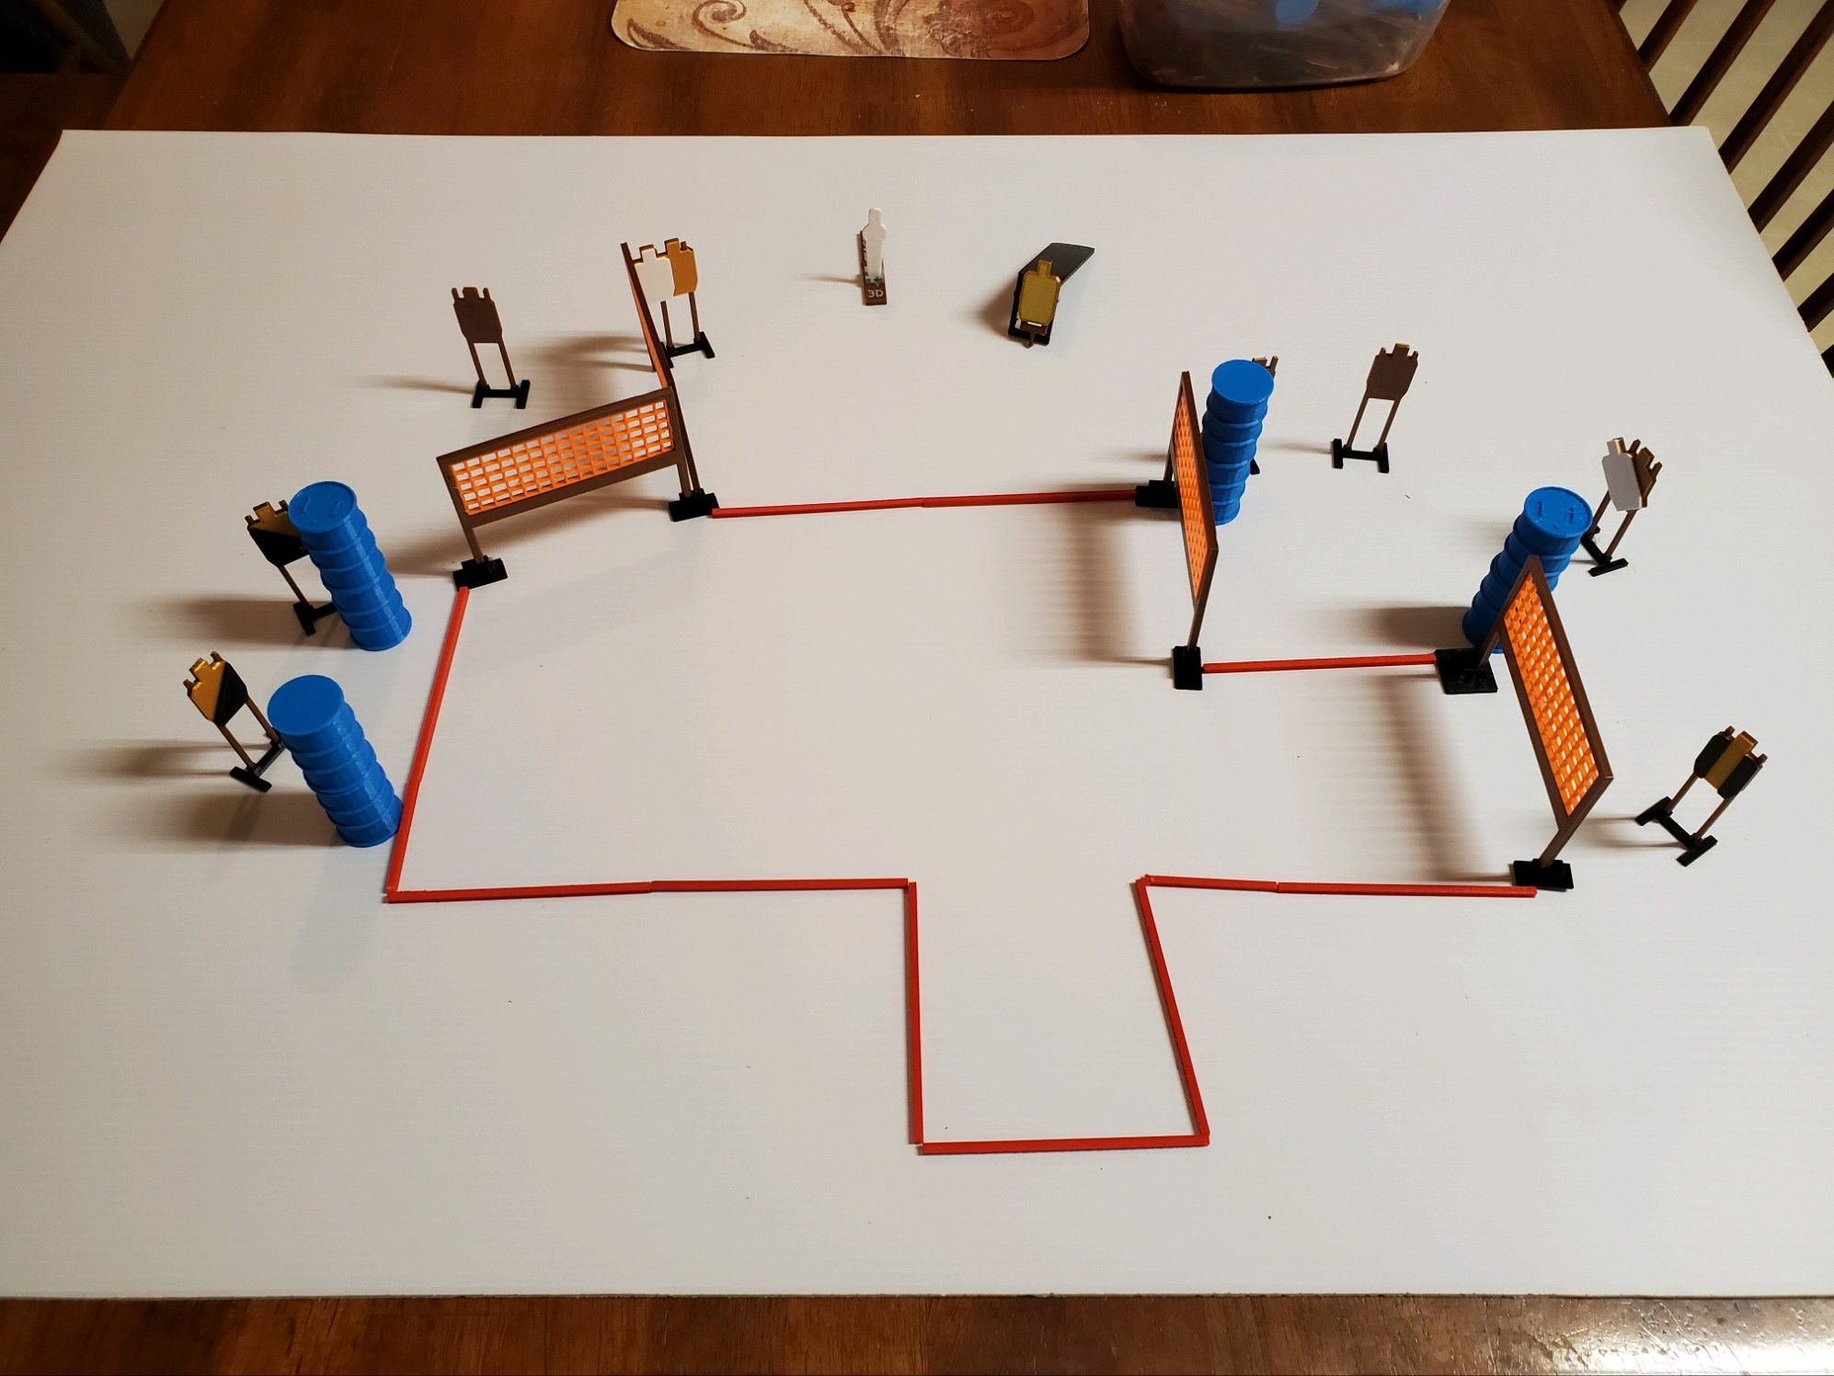
 | Dothan Practical Shooters – USPSA Match Twist and Shout Course Designer : Jerry Copeland Bay: B3
Round Count 19 rounds 9 IPSC 1 colt popper
Equipment List 7 wall feet 1 left diag, 2, right diag, 1 tux 7 targets (5 + 2NS)

Slide 2
Twist and Shout
Written Stage Briefing
Scoring: Comstock Rounds: 19
Targets: 9 IPSC, 1 steel
Handgun start position: anywhere inside the shooting area, wrists below belt. Handgun is loaded and holstered.
PCC start position: anywhere inside the shooting area, stock on belt. Loaded carbine is held with both hands, safety on.
Stage Procedure: on the audible start signal, engage target as they become available from within the shooting area.

